Slide 1
Machine Learning Techniques for Customer Churn Prediction
MIS49Y Project
Instructor: Değer Ayata
Group HAGS

Slide 2
Data
Data is acquired from Kaggle
https://www.kaggle.com/datasets/blastchar/telco-customer-churn
The data contains customer information of a telecom company
Customer churn dataset
Can be used to analyze why customers leave or stay
Companies can benefit from analyzing customer churn data by developing new sales techniques and offering special offers to retain customers

Slide 3
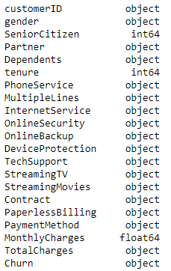
Data
Data consists of 21 features and 7043 customer information
Each feature and their datatype can be seen below.

Slide 4
Data Preprocessing
The dataset contains mainly categorical data.
Machine learning models mostly require numerical data.
So, categorical data is converted to numerical data by changing “Yes” and “No” into “0” and “1”, and by using dummy variables.
Null elements are dropped from the dataset.
After all values are numeric, dataset is standardized

Slide 5
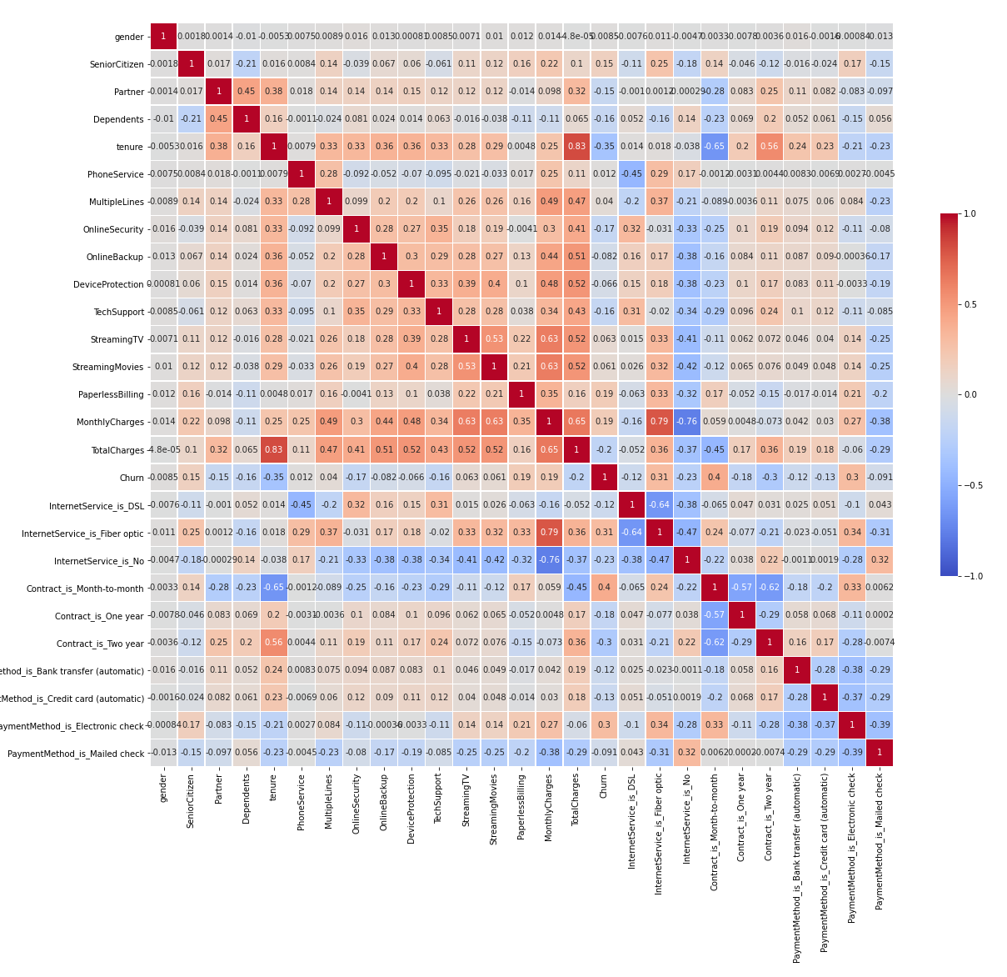
Data Visualization
Correlation matrix of the dataset is created.
Effect of each feature on other features can be observed from analyzing this heatmap.
As it can be seen in the correlation matrix, "Contract Type", "Internet Service" and "Tenure" are the most correlated features with "Churn". "Gender" is the least correlated feature.

Slide 6
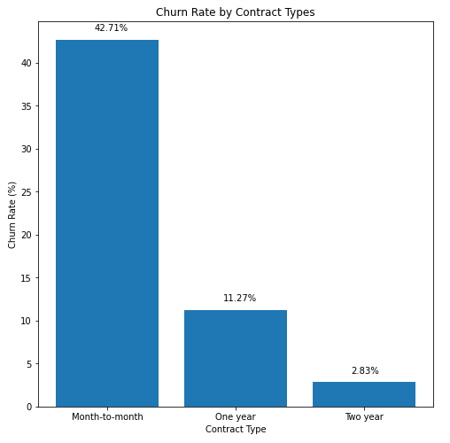
Data Visualization
As the bar plot shows, customers with month-to-month contract are prone to leaving more than other customers with different contract types.

Slide 7
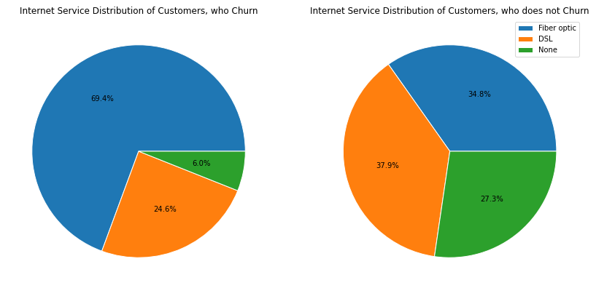
Data Visualization

Slide 8
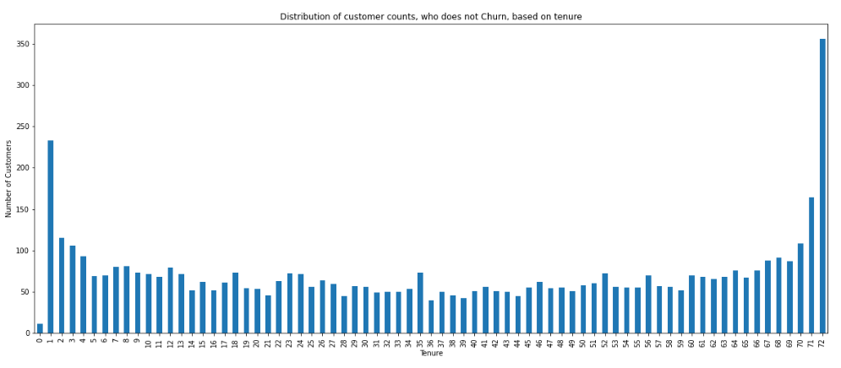
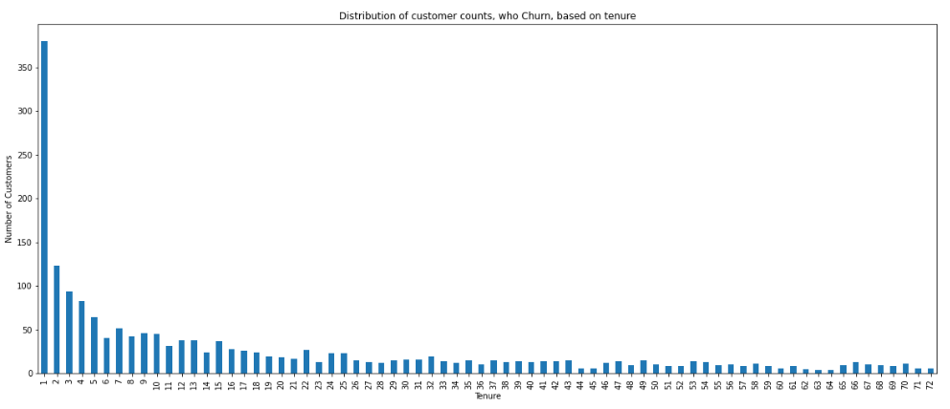
Data Visualization

Slide 9
Machine Learning Techniques
3 different ML algorithms are used in this study, which are:
Logistic Regression
XGBoost
Gradient Boosting
Hyperparameter tuning is applied to 2 of these algorithms, namely:
XGBoost
Gradient Boosting
Hyperparameter tuning is done by using Grid Search.

Slide 10
Hyperparameter Tuning
XGBoost
'n_estimators': [100,250, 500]
'subsample': [0.6, 0.8, 1.0]
'gamma' : [0,1,5]
'max_depth': [3, 4, 5]
'learning_rate': [0.1,0.3, 0.5]
Best parameters:
'gamma': 1
'learning_rate': 0.1
'max_depth': 3
'n_estimators': 100
'subsample': 0.6
XGBoost
'n_estimators': [5,50,250,500]
'max_depth': [1,3,5,7,9]
'learning_rate': [0.01,0.1,1,10,100]
Best parameters:
'learning_rate': 0.1
'max_depth’: 1
'n_estimators’: 500

Slide 11
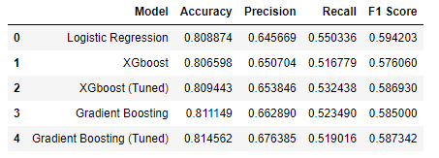
Machine Learning Model Results
As it can be seen in the table, Tuned Gradient Boosting model has the highest accuracy and precision values. F1 Score of this model is also close to highest value. Therefore, Tuned Gradient Boosting model is selected to be the best model for this dataset.

Slide 12
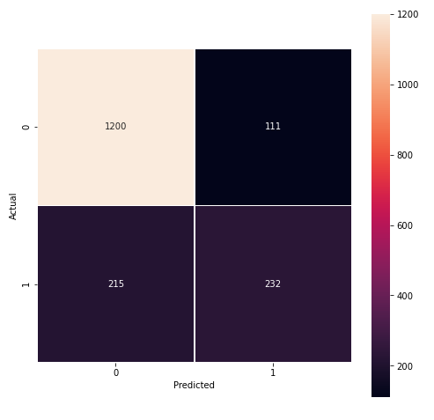
Results
Confusion matrix created by the results of Tuned Gradient Boosting model

Slide 13
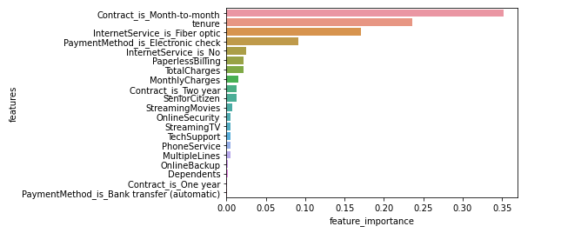
Results
Feature importance plot considering the results of Tuned Gradient Boosting model.

Slide 14
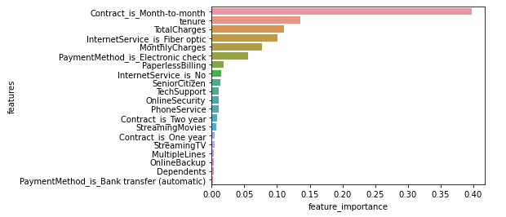
Results
Feature importance plot considering the results of Gradient Boosting model.

Slide 15
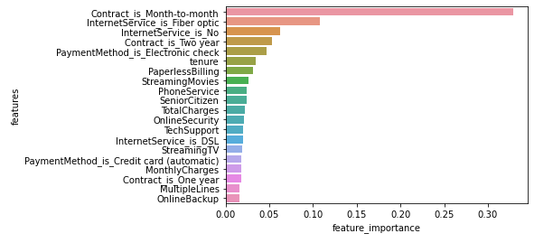
Results
Feature importance plot considering the results of XGBoost model.

